Slide 1
Complying with
FDA-Requirements
Abbreviated Investigational Device Exemptions (IDE)
Abbreviated IDE Checklist Overview
ECS-HSR Version Date: July 20, 2022

Slide 2
Introduction
All clinical evaluations of investigational devices, unless exempt, must have an FDA approved Investigational Device Exemption (IDE) and IRB-approved before the study is initiated.
Clinical investigations require an IDE unless exempt.
Abbreviated IDE applies when:
The device is nonsignificant risk (NSR).
No FDA submission is required.
Responsibility must be clearly assigned (sponsor vs. investigator).

Slide 3
IDE Overview & Abbreviated IDE Context
IDE Requirement: All investigational device studies (unless exempt) require FDA-approved and IRB-approved IDE before starting.
Purpose of IDE: Allows lawful shipment of a device for investigation without full commercial distribution compliance.
Abbreviated IDE: Applies to Nonsignificant Risk (NSR) devices.
No FDA submission required, but partial IDE compliance is mandatory.
Sponsor Role: Defined under 21 CFR 812 as the individual/entity initiating the study. Must be clearly identified in writing before the study begins to ensure compliance with responsibilities are understood.

Slide 4
IRB Approval & Informed Consent
IRB Approval (§812.2(b)(1)(ii)):
Provide rationale for NSR determination.
Informed Consent (§812.2(b)(1)(iii)):
Ensure consent is obtained and documented.

Slide 5
Sponsor Responsibilities Overview
Provide Reviewing IRB Justification For Non-significant Risk
Device Labeling
Ensure Investigators Obtain Informed Consent
Monitoring Investigations
Recordkeeping And Reporting
Investigator Oversight
Evaluate Unanticipated Device Effects
Comply With Prohibitions Against Promotion
ClinicalTrials.gov Registration

Slide 6

ClinicalTrials.gov Registration
Registration on ClinicalTrials.gov, if applicable.
Direct questions to Patrick Fawcett, Information Disclosure Administrator (ctgov@pitt.edu), or access additional resources at Clinical Trial Registration and Transparency Support.

Slide 7
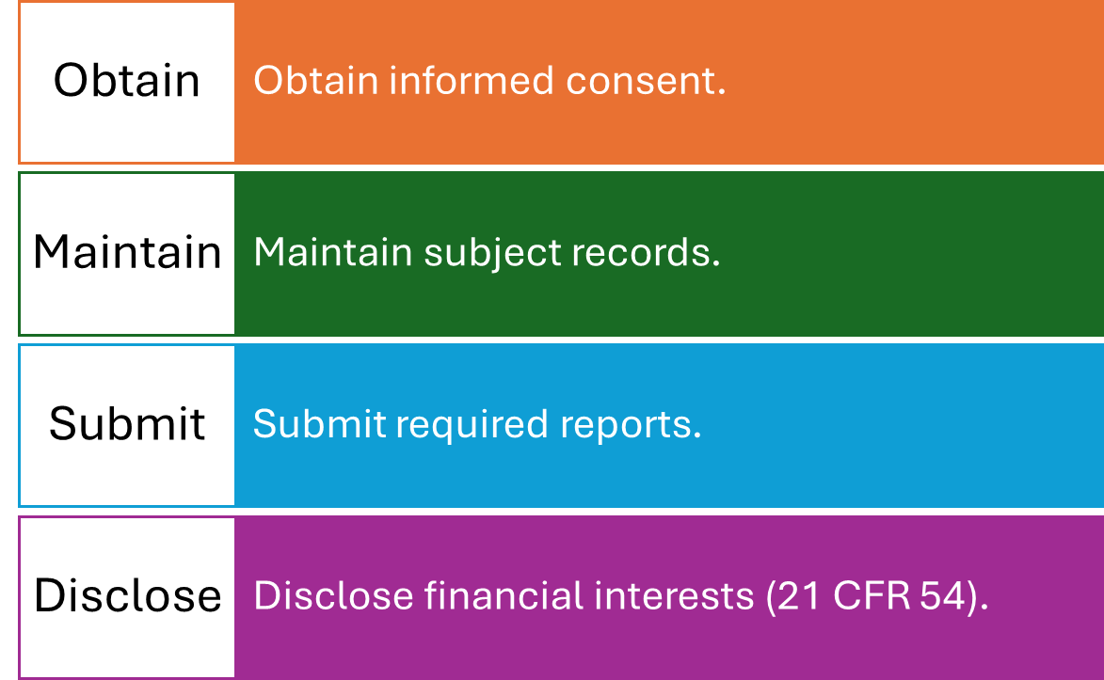
Investigator Responsibilities

Slide 8
Device Labeling (§812.5)
LABELS MUST INCLUDE:
Manufacturer Info
Quantity (If Applicable)
“Caution: Investigational Device...” Statement
Contraindications, Warnings
Include labeling info in the protocol.

Slide 9
Monitoring Investigations (§812.46)
Monitor qualifications required.
1
Provide written monitoring procedures.
2
Identify and record monitor information.
3

Slide 10
Sponsor Recordkeeping & Reporting
Maintain records per §812.140(b)(4) & (5):
Device use, objectives, investigators, IRBs.
Complaints, manufacturing practices.
Submit reports per §812.150(b)(1)-(3), (5)-(10).

Slide 11
Investigator Records & Reports
ENSURE INVESTIGATORS MAINTAIN:
Subject case history and device exposure.
Medical records and informed consent documents.
Reports: AE, IRB withdrawal, consent issues.

Slide 12
Adverse Device Effects
IF UNREASONABLE RISK IS FOUND:
Terminate Study Within 5 Working Days.
Cannot Resume Without IRB (And Possibly FDA) Approval.

Slide 13
Prohibitions (§812.7)
No promotion or commercialization.
No misrepresentation of safety or effectiveness.
Avoid unduly prolonging investigation.

Slide 14
Summary & Best Practices
Confirm sponsor and investigator responsibilities.
Follow labeling and consent procedures.
Keep clear records and monitor investigations.
Ensure NSR justification is sound.

Slide 15
Additional Resources & Citations
IND & IDE Support. (2022, July 20). Abbreviated IDE Checklist. https://www.ecshsr.pitt.edu/ind-ide-support/abbreviated-ide
FDA PowerPoint on Design Controls. https://www.fda.gov/media/116762/download
FDA 21 CFR 820.30 Designed Controls.
https://www.ecfr.gov/current/title-21/chapter-I/subchapter-H/part-820/subpart-C/section-820.30
FDA Guidance Document Information Sheet Guidance for IRBs, Clinical Investigators, and Sponsors Significant Risk and Nonsignificant Risk Medical Device Studies (2006, January). https://www.fda.gov/media/75459/download

